Slide 1
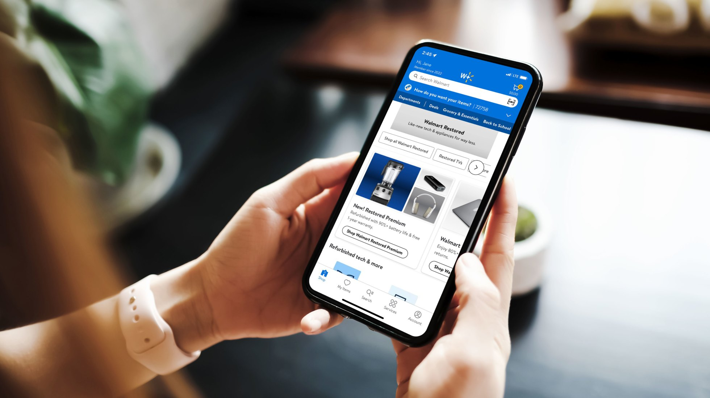

MyAssistant
Ask My Page Experience
- “making the complex simple”
EBS Product Showcase— 2024
Notes:
Today, we have the privilege of presenting the product demo for MyAssistant.
The one liner definition of MyAssitannt is “A Walmart internal version of ChatGPT which provide private and secured use of Generative AI”
While our focus will be on MyAssistant, it is also crucial to highlight another significant product, Me@Campus, which serves as an internal portal for all Walmart associates.
Over time, MyAssistant has successfully established its own identity, yet remains an integral part of Me@Campus.
Together, these two applications strive to achieve a common goal: making the complex simpler.

Slide 2



MyAssistant Foundation
A Walmart internal version of ChatGPT which provide private and secured use of Generative AI
Conventional ChatBot
Power of AI
Walmart Knowledge
Notes:
1 MyAssistant has three built-In Foundation blocks:– Traditional Chat Bot, Power of AI and Trained with Walmart knowledge.
Already Market ready made Chat Bot available but why we need some thing new and first and formost answer is Security
Second is Walmart Sensitive information we can’t pass outside hence we need our own chatbot.

Slide 3

What ‘MyAssistant’ provides additional?
6. Experience will be chosen in future based on user need
LEARNT TO PROMPT
PROVIDE PROMPT TRAINING EXPERIENCE AND FEEDBACK THOUGH CONVERSATIONAL APPROACH
CREATE PERFORMANCE GOAL
ASSOCIATES CAN USE AI TO CREATE PERFORMENCE GAOLS.
1. Represent the journey of a user in MyAssistant.
ASK ME DOC
ASSOCIATE CAN HAVE NATURAL LANGUAGE QUESTION ANSWERING ON UPLOADED DOCUMENTS AND GET INSIGHT
Experience
5. Role Based enablement.
2. Developed in in Plug-N-Play model.
PEOPLE DATA EXPERIENCE
THIS EXPERIENCE WILL PROVIDE USERS WITH VALUABLE INSIGHTS ON STORES AND ASSOCIATES
HELP ME WRITE
PROVIDE WALMART KNOWLEDGE WORKERS TO HAVE A BACK-AND-FORTH CONVERSATION AND AND EVENTUALY HELP TO WRITE CONTENT.
ONE WALMART SEARCH
SEARCH WALMART AEM INFORMATION THROUGH CHAT.
Curated Flow designated to solve specific user problem
4. Easy uplift will happen on each experience/
3. Design to solve specific user problem.
Experience are how associates find Walmart information in My Assistant
Notes:
Plugin represent a component whereas Experience represent a journey
Get detainis of stores also generate reports and analysis relevant trends.
Learn to prompt teach to get output which is most effective b teaching better prompting.
HMR: Guide user to write better content with Walmart information.

Slide 4
What ‘MyAssistant’ provides additional?
ASK ME DOC
ASSOCIATE CAN HAVE NATURAL LANGUAGE QUESTION ANSWERING ON UPLOADED DOCUMENTS AND GET INSIGHT
LEARNT TO PROMPT
PROVIDE PROMPT TRAINING EXPERIENCE AND FEEDBACK THOUGH CONVERSATIONAL APPROACH
CREATE PERFORMANCE GOAL
ASSOCIATES CAN USE AI TO CREATE PERFORMANCE GOALS FOR YEAR-END EVALUATION.
ASK ME DOC
ASSOCIATE CAN HAVE NATURAL LANGUAGE QUESTION ANSWERING ON UPLOADED DOCUMENTS AND GET INSIGHT
LEARNT TO PROMPT
PROVIDE PROMPT TRAINING EXPERIENCE AND FEEDBACK THOUGH CONVERSATIONAL APPROACH
CREATE PERFORMANCE GOAL
ASSOCIATES CAN USE AI TO CREATE PERFORMANCE GOALS FOR YEAR-END EVALUATION.
6. Experience will be chosen in future based on user need
1. Represent the journey of a user in MyAssistant.
5. Role Based enablement.
PEOPLE DATA EXPERIENCE
THIS EXPERIENCE WILL PROVIDE USERS WITH VALUABLE INSIGHTS ON STORES AND ASSOCIATES
HELP ME WRITE
PROVIDE WALMART KNOWLEDGE WORKERS TO HAVE A BACK-AND-FORTH CONVERSATION AND AND EVENTUALY HELP TO WRITE CONTENT.
ONE WALMART SEARCH
SEARCH WALMART AEM INFORMATION THROUGH CHAT.
PEOPLE DATA EXPERIENCE
THIS EXPERIENCE WILL PROVIDE USERS WITH VALUABLE INSIGHTS ON STORES AND ASSOCIATES
HELP ME WRITE
PROVIDE WALMART KNOWLEDGE WORKERS TO HAVE A BACK-AND-FORTH CONVERSATION AND AND EVENTUALY HELP TO WRITE CONTENT.
ONE WALMART SEARCH
SEARCH WALMART AEM INFORMATION THROUGH CHAT.
2. Developed in in Plug-N-Play model.
4. Easy uplift will happen on each experience/
3. Design to solve specific user problem.
Experience are how associates find Walmart information in My Assistant
Curated Flo designated to solve specific user problem
Notes:
Plugin represent a component whereas Experience represent a journey
Get detainis of stores also generate reports and analysis relevant trends.
Learn to prompt teach to get output which is most effective b teaching better prompting.
HMR: Guide user to write better content with Walmart information.

Slide 5




Experience - Ask My Page
Standalone
https://myassistant.walmart.com/
Summarizing and identifying key points from a webpage
Creating a list of FAQs tailored to the web page content
Responding to user inquiries related to the web page
Proposing engaging prompts or actions inspired by the web page
Me@Campus
https://campus.walmart.com/home
ASK MY PAGE
Browser Extension
A plugin as side panel of the browser.
Notes:
Browser Extension
Plugin represent a component whereas Experience represent a journey
Get detainis of stores also generate reports and analysis relevant trends.
Learn to prompt teach to get output which is most effective b teaching better prompting.
HMR: Guide user to write better content with Walmart information.

Slide 6




Ask My Page Deep Dive
Disclaimer Alert and User privacy consent
ASK MY PAGE
Content moderation, PII moderation, Hallucination evaluation
Chat-history maintain for accurate answer
Notes:
Browser Extension
Plugin represent a component whereas Experience represent a journey
Get detainis of stores also generate reports and analysis relevant trends.
Learn to prompt teach to get output which is most effective b teaching better prompting.
HMR: Guide user to write better content with Walmart information.

Slide 7






How ‘Ask My Page’ works?
Contains harmful/ sensitive info.
No processing
Web page from browser
Web scrapping
Content safety & PII moderation
No harmful/ sensitive info.
Ingestion to LLM for Q&A
Ingestion Flow

Slide 8



How ‘Ask My Page’ works?
Integration of User query and Web page content to LLM prompt
Web page content understanding using LLM
Response generation using LLM
Retrieval Flow
User query about the web page
Notes:
Based on Webpage content

Slide 9
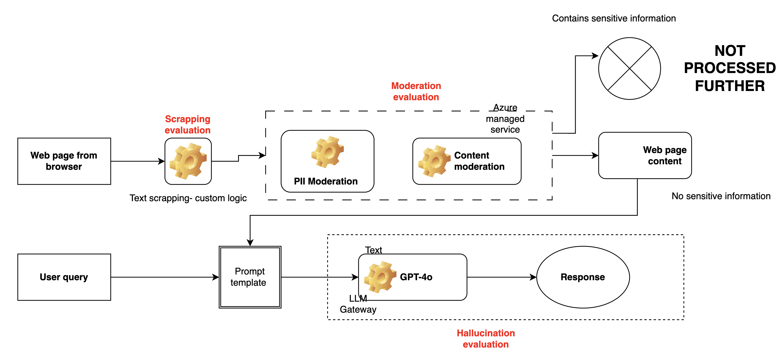
‘Ask My Page’
‘Ask My Page’ Accuracy Measures

Slide 10
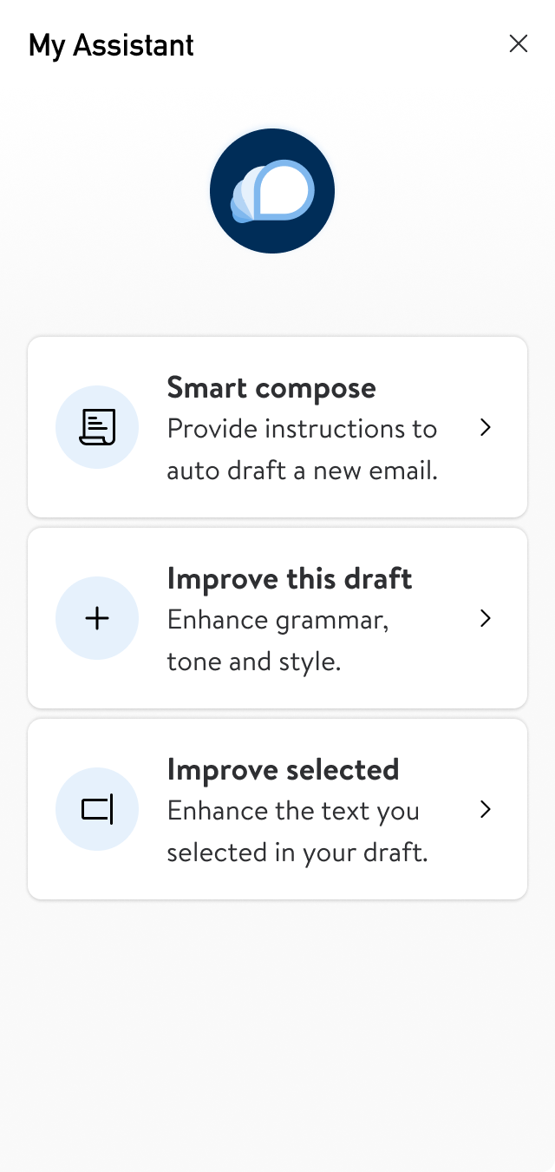

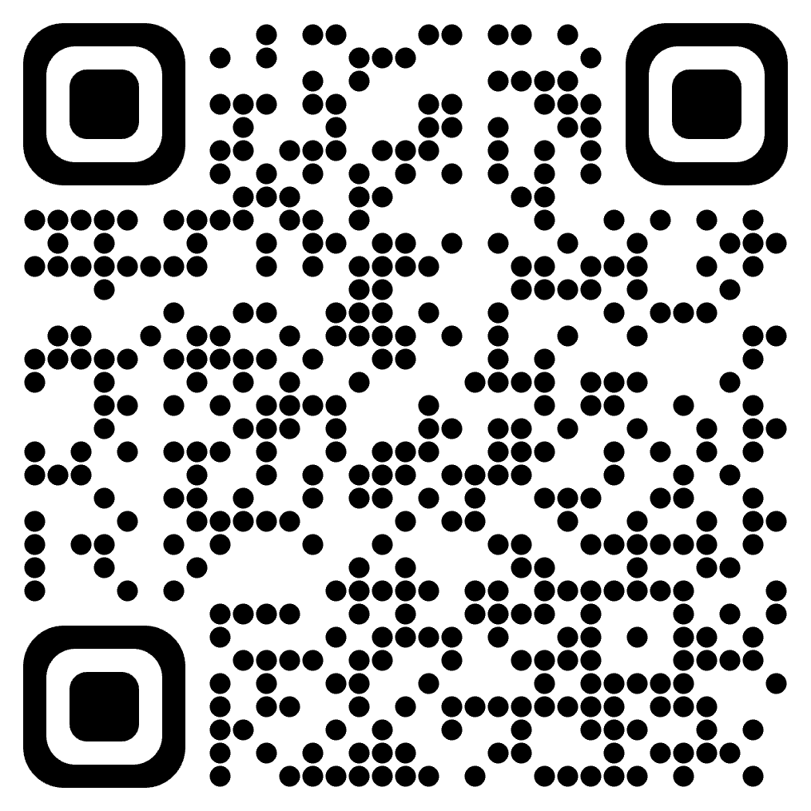
Qyestions
My Assistant link
Photos
https://corporate.walmart.com/newroom/media-library
Brand
https://walmartbrandcenter.lingoapp.com/
Scan QR Code
10
Walmart Confidential
Notes:
Plugin represent a component whereas Experience represent a journey
Get detainis of stores also generate reports and analysis relevant trends.
Learn to prompt teach to get output which is most effective b teaching better prompting.
HMR: Guide user to write better content with Walmart information.

Slide 11
Qyestions
My Assistant link
Photos
https://corporate.walmart.com/newsroom/media-library
Brand
https://walmartbrandcenter.lingoapp.com/
Scan QR Code
11
Walmart Confidential
Notes:
Plugin represent a component whereas Experience represent a journey
Get detainis of stores also generate reports and analysis relevant trends.
Learn to prompt teach to get output which is most effective b teaching better prompting.
HMR: Guide user to write better content with Walmart information.

Slide 12
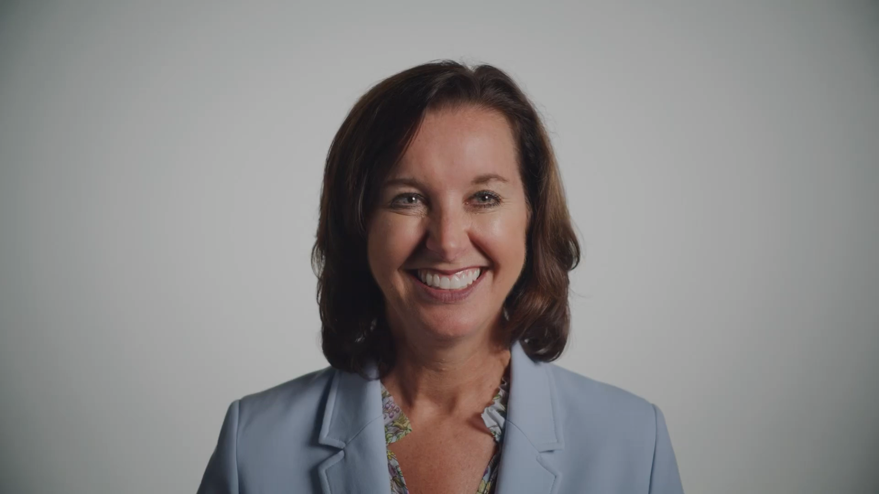
Helpful Links
RESOURCES

Slide 13
MyAssistant- Chrome Extension
Standalone
Me@Campus
Browser Extension
https://myassistant.walmart.com/
https://campus.walmart.com/home
A plugin as side panel of the browser.
20k active weekly users from this experience.
0.5 hr mins avg. time save * 55K home-office associates* 48 weeks avg. * $52 avg. cost ~ $6,86,40,000

Slide 14
MyAssistant- Engineering Excellence
6. Satisfaction is the goal of each experience.
1. Represent the journey of a user in MyAssistant.
5. Role Based enablement.
2. Zero plugin or can use one or multiple plugins.
4. Easy uplift will happen when plugin will evolve to Agent.
3. Design to solve specific user problem.
Notes:
1. developed from chat GPT 4.0
2. Isolate the risks: Compartmentalize the risks for individual tools/plugin-based services. A bad agent could be dropped from the library.
Mobilize a broader developer community: Develop flagship plugins but also enable a framework to onboard plugins developed by other teams.
4. RBAC: Plugins for specific requirements from a group of people. Ex: Learning content developers need image/audio generation (computationally expensive) capabilities, the plugin service will be enabled and visible to only LCDD team users.
5. User Choice: Users will be contextualized when they enter/load the plugin. Everything already integrated is not a better fitment here rather help to user prior knowledge what they want.
6 Separate terms and conditions: Users to understand and agree with the risks for incomplete answers or information before they use the plugins.
Experience represents journey of an user as well.

Slide 15
MyAssistant- Access Points
Standalone
Me@Campus
https://myassistant.walmart.com/
https://campus.walmart.com/home

Slide 16
Experience - ASK My Page
Summarizing and identifying key points from a webpage
Creating a list of FAQs tailored to the web page content
Responding to user inquiries related to the web page
Proposing engaging prompts or actions inspired by the web page
ASK MY PAGE
Notes:
Plugin represent a component whereas Experience represent a journey
Get detainis of stores also generate reports and analysis relevant trends.
Learn to prompt teach to get output which is most effective b teaching better prompting.
HMR: Guide user to write better content with Walmart information.

Slide 17
Experience
ASK ME DOC
ASSOCIATE CAN HAVE NATURAL LANGUAGE QUESTION ANSWERING ON UPLOADED DOCUMENTS AND GET INSIGHT
LEARNT TO PROMPT
PROVIDE PROMPT TRAINING EXPERIENCE AND FEEDBACK THOUGH CONVERSATIONAL APPROACH
CREATE PERFORMANCE GOAL
ASSOCIATES CAN USE AI TO CREATEPERFORMENCE GAOLS.
PEOPLE DATA EXPERIENCE
THIS EXPERIENCE WILL PROVIDE USERS WITH VALUABLE INSIGHTS ON STORES AND ASSOCIATES
HELP ME WRITE
PROVIDE WALMART KNOWLEDGE WORKERS TO HAVE A BACK-AND-FORTH CONVERSATION AND AND EVENTUALY HELP TO WRITE CONTENT.
ONE WALMART SEARCH
SEARCH WALMART AEM INFORMATION THROUGH CHAT.
Notes:
Plugin represent a component whereas Experience represent a journey
Get detainis of stores also generate reports and analysis relevant trends.
Learn to prompt teach to get output which is most effective b teaching better prompting.
HMR: Guide user to write better content with Walmart information.

Slide 18
MyAssistant- Access Points
Standalone
Me@Campus
https://myassistant.walmart.com/
https://campus.walmart.com/home

Slide 19
MyAssistant- Chrome Extension
Standalone
Me@Campus
Browser Extension
https://myassistant.walmart.com/
https://campus.walmart.com/home
A plugin as side panel of the browser.

Slide 20

MyAssistant- Relevance
aa
Instant, accurate responses to associate’s queries about Walmart policies.
Quick and valuable comprehension for lengthy documents.
Granular business insights using its inbuilt business intelligence capability.
An AI-powered chatbot integrated with Walmart knowledge and multi-faceted capabilities designed for Walmart associates.
Personalized chat experience using its natural language interface .

Slide 21



MyAssistant- Initial challenges
How To Onboard Walmart policy In LLM model ?
Plugin
Agent
Notes:
ChatBot and GenAI market available model already exist but bringing Walmart knowledge was the challenge.

Slide 22
Plugin & Agent
Plugin
Agent
An opt-in approach requires associates to explicitly select a component in order to include it as part of the conversation.
A smarter approach involves calling a component implicitly based on the user's question when it is needed.

Slide 23
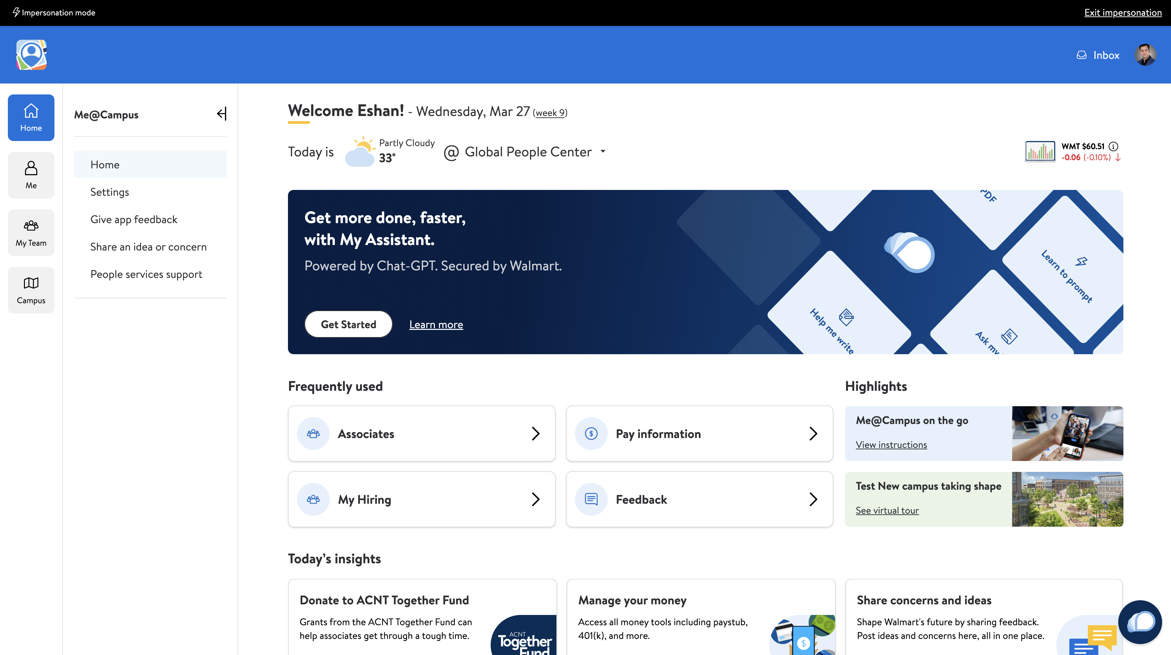
MyAssistant- Access Points
Standalone
https://myassistant.walmart.com/
Me@Campus
https://campus.walmart.com/home
Me@Campus is a Platform APP where multiple “Mini Apps” Exist.
“Mini Apps” are nothing But a self-sufficient Micro services.

Slide 24
MyAssistant- Chrome Extension
Standalone
Me@Campus
Browser Extension
https://myassistant.walmart.com/
https://campus.walmart.com/home
A plugin as side panel of the browser.
20k active weekly users from this experience.
0.5 hr mins avg. time save * 55K home-office associates* 48 weeks avg. * $52 avg. cost ~ $6,86,40,000

Slide 25
MyAssistant Evolution
Plug in will be evolved to Agent and successfully promoted to perform necessary actions without less user intervention.
Short Term
Plugins will be explicitly called by the user
Intermediate Term
Users will be asked to call plugin when needed
Long term
Plugins will be implicitly called without user’s intervention
Notes:
First the user need to call plugin, then Myassitant will recommend the plugin and finally it will call plugin when required

Slide 26
World of Plugins
DOC AI
DOCUMENT ANALYTICS PLUGIN ALLOW USER TO UPLOAD AND QUERY THEIR DOCUMENT
PROMPT MODIFICATION
HELP TO WRITE APPROPRIATE PROMPT TO USER
CONVERSATIONAL TRANSL.N
Translate spoken words from one language to another in real-time
ASSOCIATE BENEFIT
ENABLE THE NEXT GENERATION BENEFITS SELF-SERVICE FOR ASSOCIATES AND ACCESS INFORMATION IN NATURAL LANGUAGE
POLICY GUIDE
BASED ON POLICY RELETED QUESTIONS PROVIDE CLEAR AND CONCISE ANSWERS
POLICY GUIDE
BASED ON POLICY RELETED QUESTIONS PROVIDE CLEAR AND CONCISE ANSWERS
Notes:
Doc AI:
This Plugin leverage LLM and and makes document analysis and information retrieval a breeze for me@capus users.
users can easily generate summaries from lengthy zoom meeting transcripts, engaged in interactive Q&A sessions with large files like white papers, PRDs and reports, and even automatically draft emails using information extracted from relevant PDF documents.
it streamlines PDF document analysis as well/
Associate Benefits
Associates can provide about their yearly deductibles for each major medical plans, Yearly annual check up packages, dental cleavage and eye-sight check-ups etc, Also this plugin has features like upload document and get answer through QA,
Career exploration:
Associates can search job based on particular Geographic location like Bentonvelle or Bangalore, based on role like “data scientist, Store Manager,
Associate Search: User can find in natural languages question like “all available datascientists in bangalore?” “List of product managers in Chennai”, Store as well In a store who can decorate cakes?”

Slide 27
Experience
ASK ME DOC
ASSOCIATE CAN HAVE NATURAL LANGUAGE QUESTION ANSWERING ON UPLOADED DOCUMENTS AND GET INSIGHT
LEARNT TO PROMPT
PROVIDE PROMPT TRAINING EXPERIENCE AND FEEDBACK THOUGH CONVERSATIONAL APPROACH
CREATE PERFORMANCE GOAL
ASSOCIATES CAN USE AI TO CREATEPERFORMENCE GAOLS.
Experience
Curated Flow designated to solve specific user problem
PEOPLE DATA EXPERIENCE
THIS EXPERIENCE WILL PROVIDE USERS WITH VALUABLE INSIGHTS ON STORES AND ASSOCIATES
HELP ME WRITE
PROVIDE WALMART KNOWLEDGE WORKERS TO HAVE A BACK-AND-FORTH CONVERSATION AND AND EVENTUALY HELP TO WRITE CONTENT.
ONE WALMART SEARCH
SEARCH WALMART AEM INFORMATION THROUGH CHAT.
Experience are how associates find Walmart information in My Assistant
Notes:
Plugin represent a component whereas Experience represent a journey
Get detainis of stores also generate reports and analysis relevant trends.
Learn to prompt teach to get output which is most effective b teaching better prompting.
HMR: Guide user to write better content with Walmart information.

Slide 28

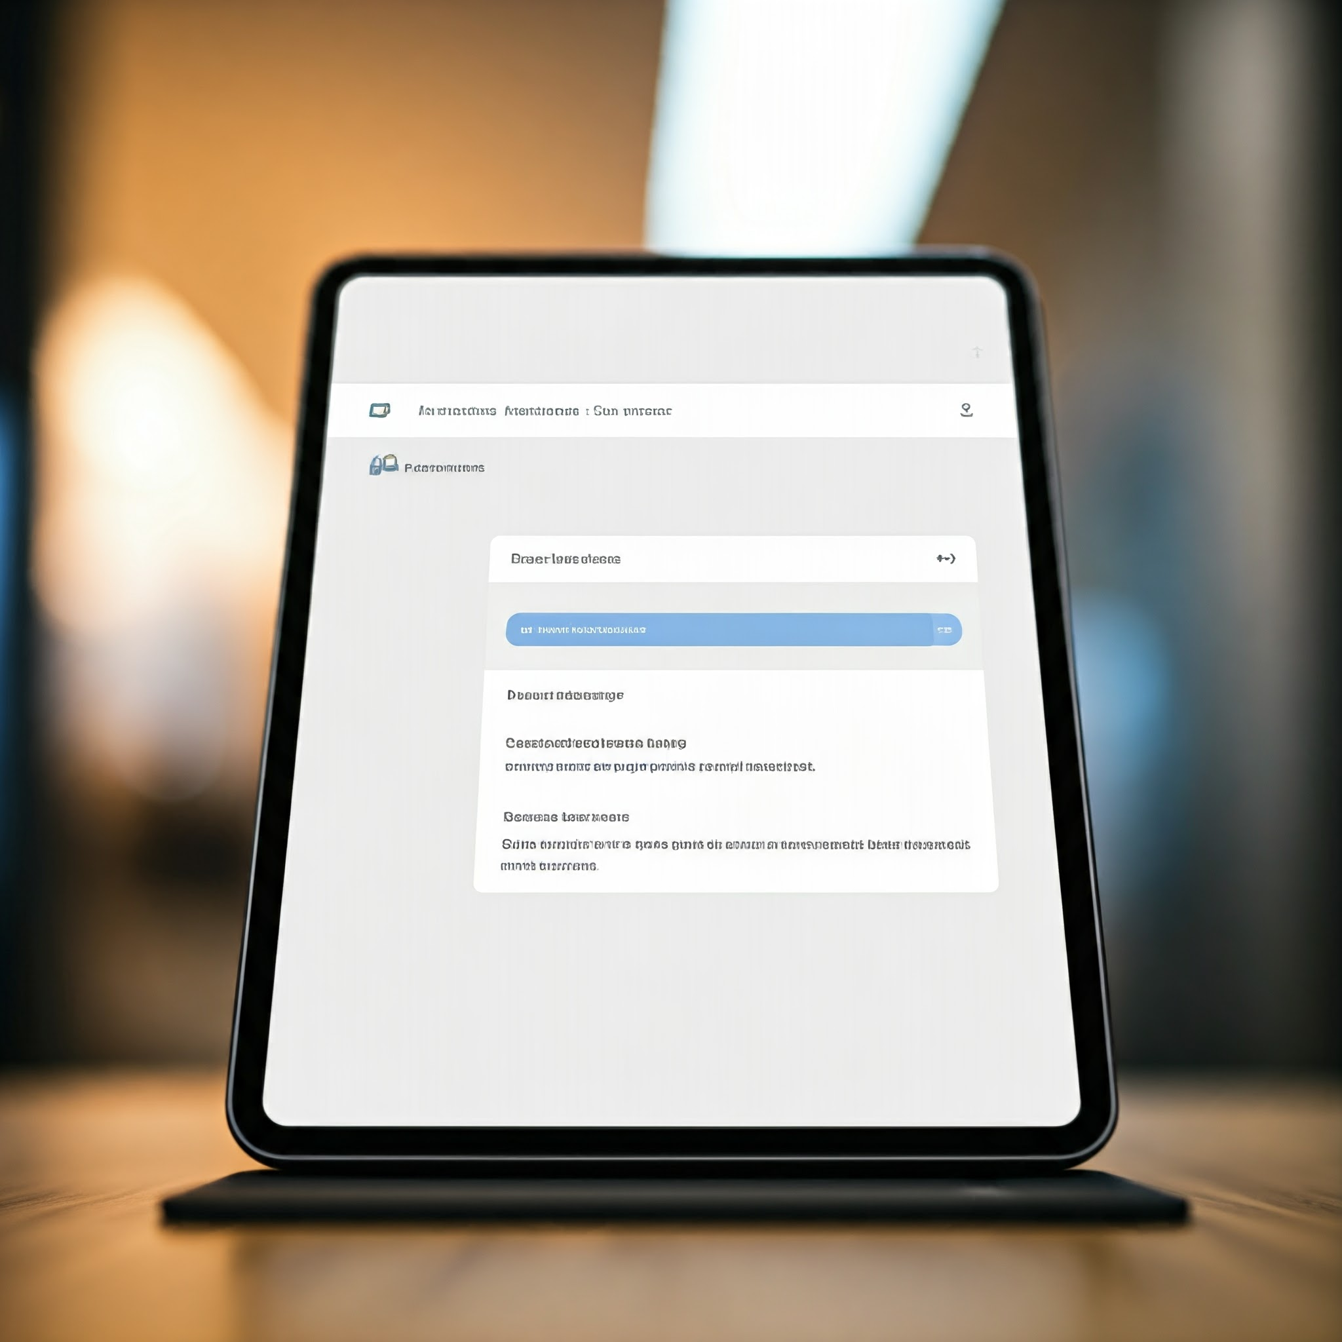
MyAssistant- A Realtime Example
WebPage AI
DOCUMENT ANALYTICS PLUGIN ALLOW USER TO UPLOAD AND QUERY THEIR DOCUMENT
Ask This Page
DOCUMENT ANALYTICS PLUGIN ALLOW USER TO UPLOAD AND QUERY THEIR DOCUMENT
take the persona of a graphic designer and generate a 3d icon which signifies authorisation. The icon should be modern.
Notes:
1

Slide 29




MyAssistant- Arch.

Slide 30
MyAssistant- Engineering Excellence
6. separate terms and conditions for each plugin.
1. Adopted from ChatGpt 4.0
6. Satisfaction is the goal of each experience.
1. Represent the journey of a user in MyAssistant.
5. user choice: Contextualize when user enter/load plugin.
5. Role Based enablement.
2. Cut-off the risk of individual tools.
2. Zero plugin or can use one or multiple plugins.
4. RBAC support – plugins for certain job role.
4. Easy uplift will happen when plugin will evolve to Agent.
3. Independent tool deployed as API.
3. Design to solve specific user problem.
Notes:
1. developed from chat GPT 4.0
2. Isolate the risks: Compartmentalize the risks for individual tools/plugin-based services. A bad agent could be dropped from the library.
Mobilize a broader developer community: Develop flagship plugins but also enable a framework to onboard plugins developed by other teams.
4. RBAC: Plugins for specific requirements from a group of people. Ex: Learning content developers need image/audio generation (computationally expensive) capabilities, the plugin service will be enabled and visible to only LCDD team users.
5. User Choice: Users will be contextualized when they enter/load the plugin. Everything already integrated is not a better fitment here rather help to user prior knowledge what they want.
6 Separate terms and conditions: Users to understand and agree with the risks for incomplete answers or information before they use the plugins.
Experience represents journey of an user as well.

Slide 31







MyAssistant- Functional Excellence
Toxicity Moderation filter
Human-like Translation
Gen AI Integrated Document Insights
Chat History Enabled
Walmart Privacy
Features
Maintain PII policy

Slide 32

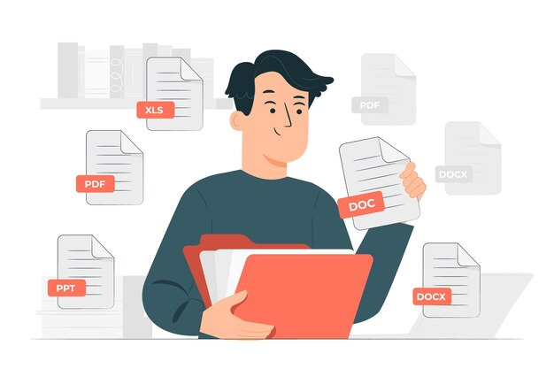



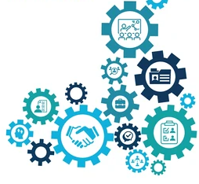


MyAssistant- Functional Excellence
Upload and ask questions on any document
Personalized Experience
Domain specific Information
Quick, intuitive answer
Marketplace
Hosted
Advantages
Predesigned Questions

Slide 33
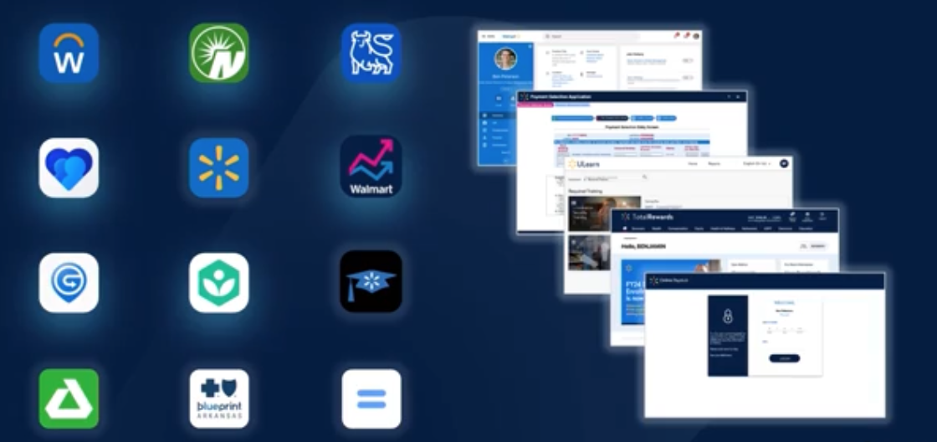

Building Philosophy – Me@Campus
Unified
Consumer Grade
Simplified
“unified experience instead of fragmented experience”
same philosophy for customers as well as associates-
“utmost satisfaction”
“making the complex simple”
-Walmart focus Power of people
Notes:
[^1]There were multiple apps in Walmart ecosystem earlier, for serving dedicated business processes and Me@Campius in a mission, to give a common platform for all those apps.
[^2]The Me@Campus is consumer-grade; As we know, in the Ecommerce world Walmart everyday serves millions of customers and always focuses on customers first. , now Me@Capus is on a mission to bring the same satisfaction to its associates.
[^3]A massive company like Walmart, of-course it has different complex processes, which pragmatically influence Walmart associate's day to day life which leads towards more productivity.

Slide 34

My Assistant – Mission and Vision
Short Term Goal
Long Term Goal
To enhance My Assistant by integrating the following capabilities
Support to multiple document formats like .XLS
Enabling multiple uploads of PDF in a single conversation chain
Provisioning cross-query analytics engine across multiple documents.
To make My Assistant - a one-stop assistant by integrating the business intelligence capabilities of:
People Bot – A virtual assistant that enables users to get instant and insightful answers about our people and organization.
Workday bot – A chatbot designed for providing a seamless job transaction for managers and associates.
A unified, world-class virtual assistant for Walmart associates
Notes:
Short term goal of MyAssitant is widening it’s exiting capabilities like
Long term Goal, In Walmart eco system there are multiple bots exists which capable of handling their own task, MyAssistant is going to provide a unique gatway of those bots.

Slide 35



Me@Campus -A brief introduction
As of now 50,000 Home Office associates are user of MyAssistant .The Product already rolled out for US and International( Canada, Mexico, Chellie) associates and will be rolled out for IDC associates soon.
Me@Campus
FOR ALL WAL MART HOME-OFFICE ASSOCIATES AN UNIQUE PLATFORM EXIST - which provide a one stop destination of information what they need most.
Notes:
[^1]For All Walmart home office Associates, a unique platform exists which provides a one-step destination of information on what each associates need most.
The name of the application is Me@campus.
The application exists in both forms as a mobile app as well as a desktop version

Slide 36

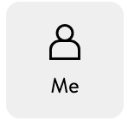
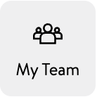
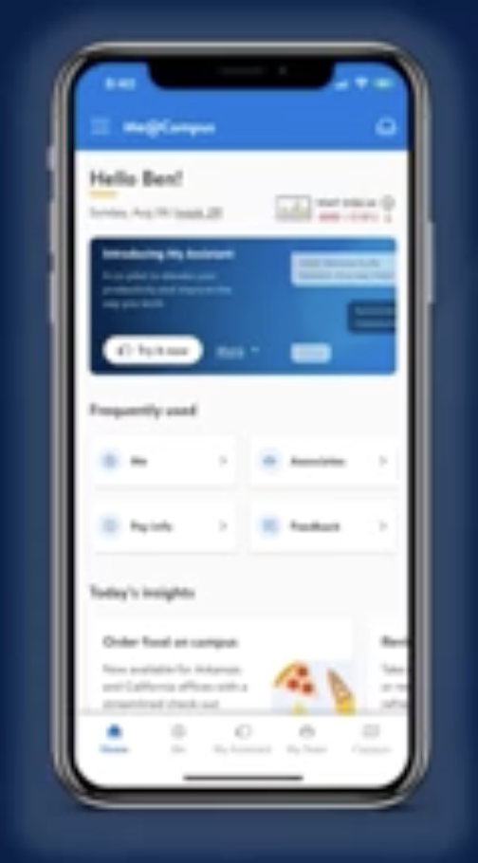
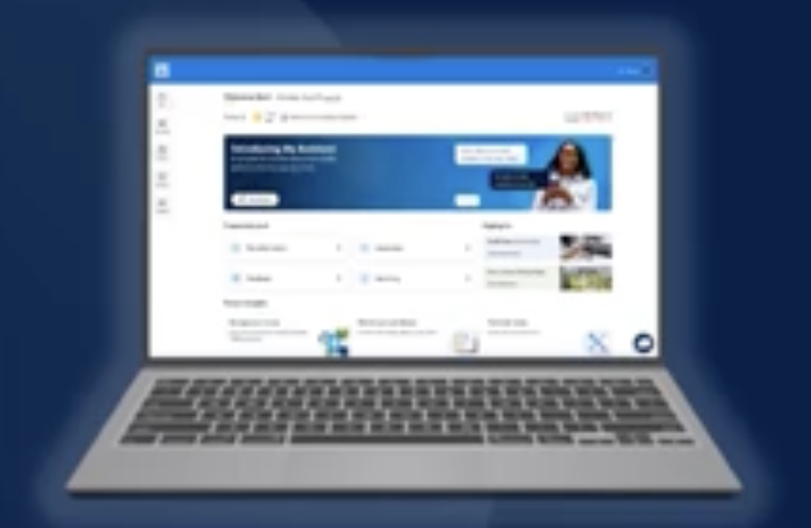

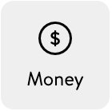

Me@Campus –Accessibility
Desktop App.
Mobile App
Notes:
Me@Campus is accessible through Mobile and Desktop as well and it has 5 major sections.

Slide 37
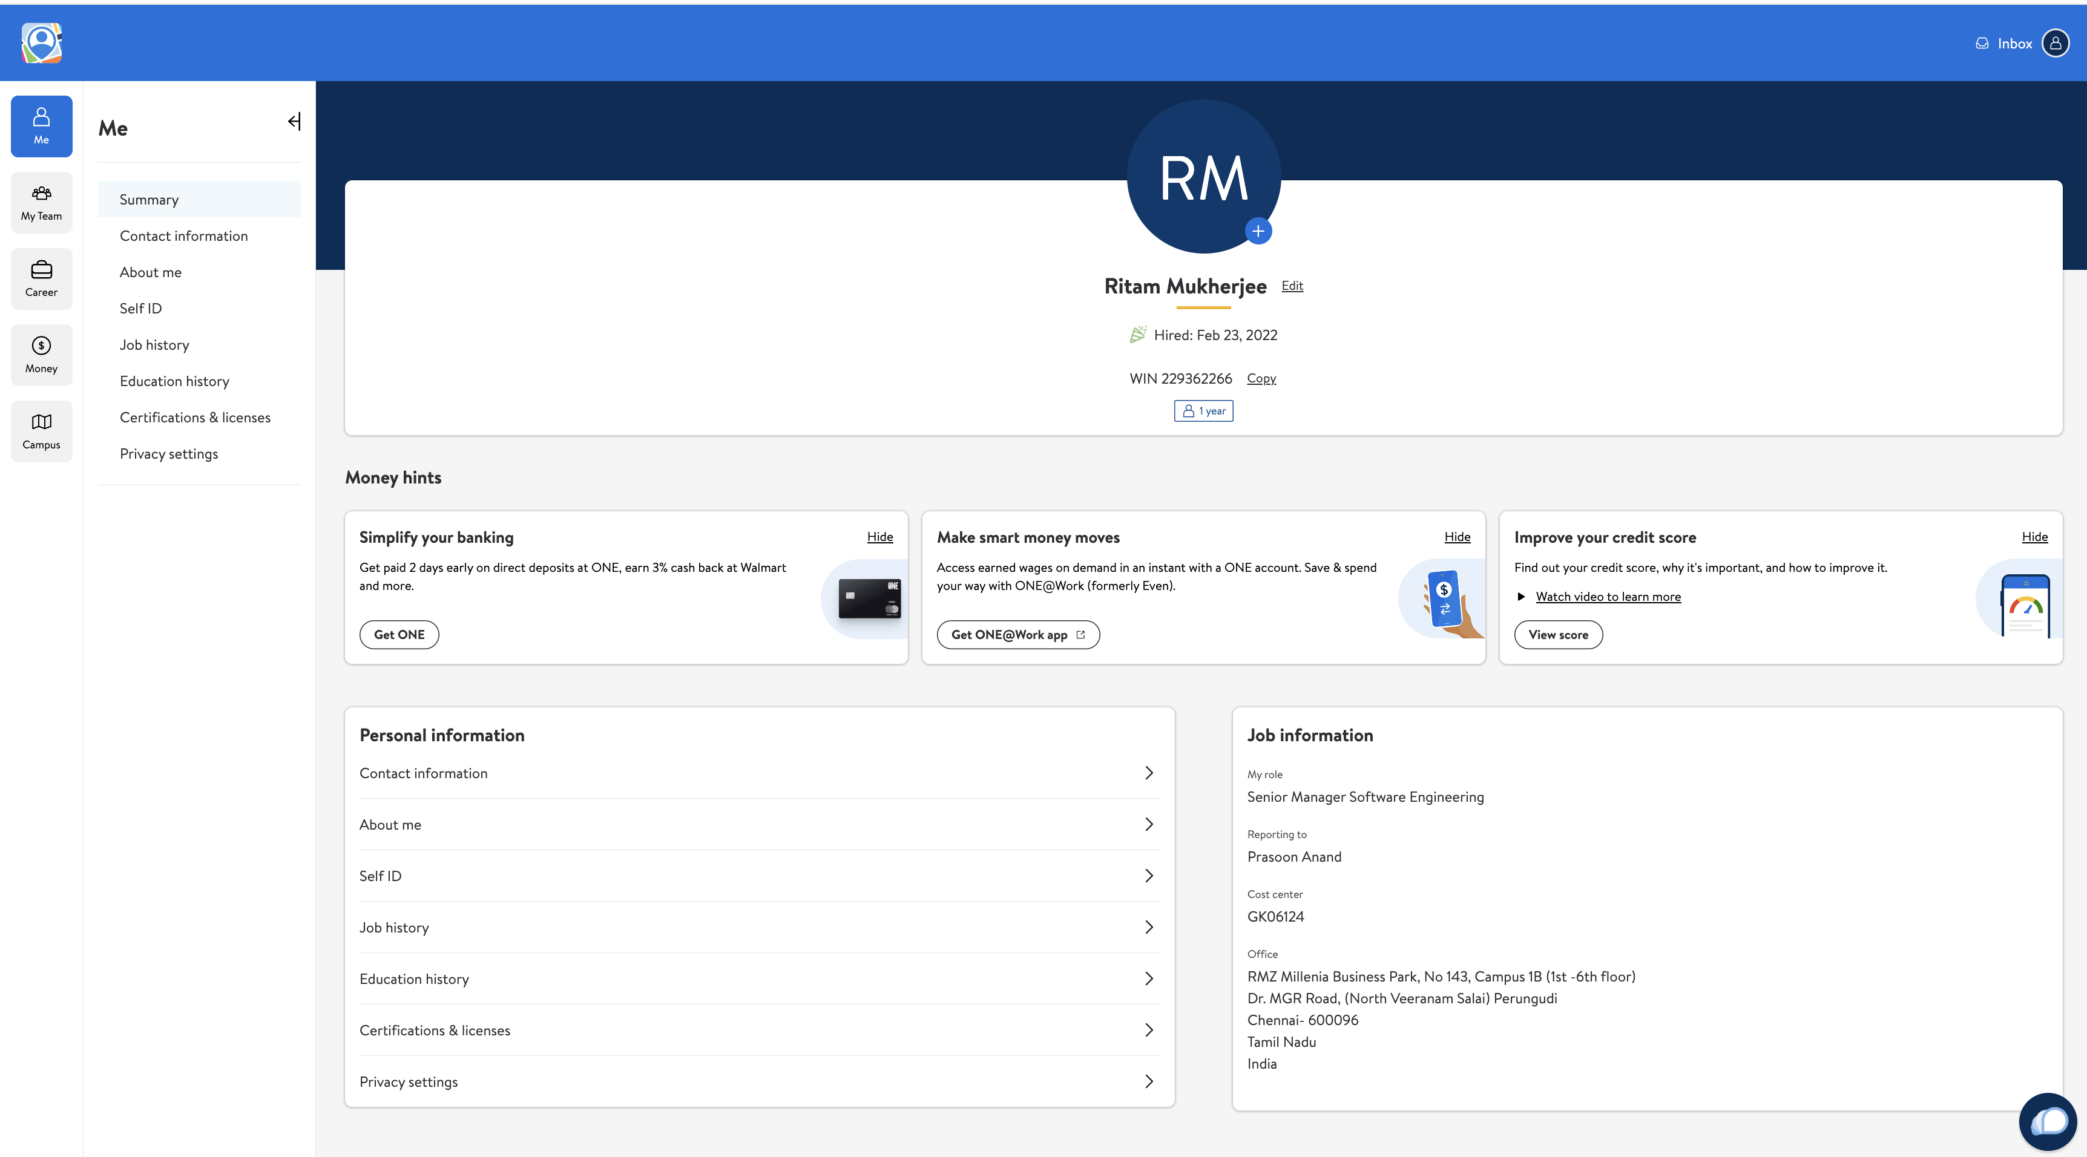
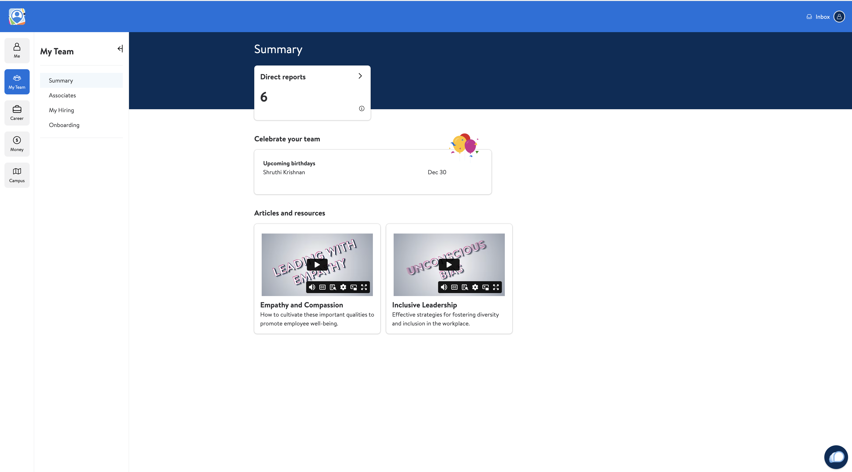

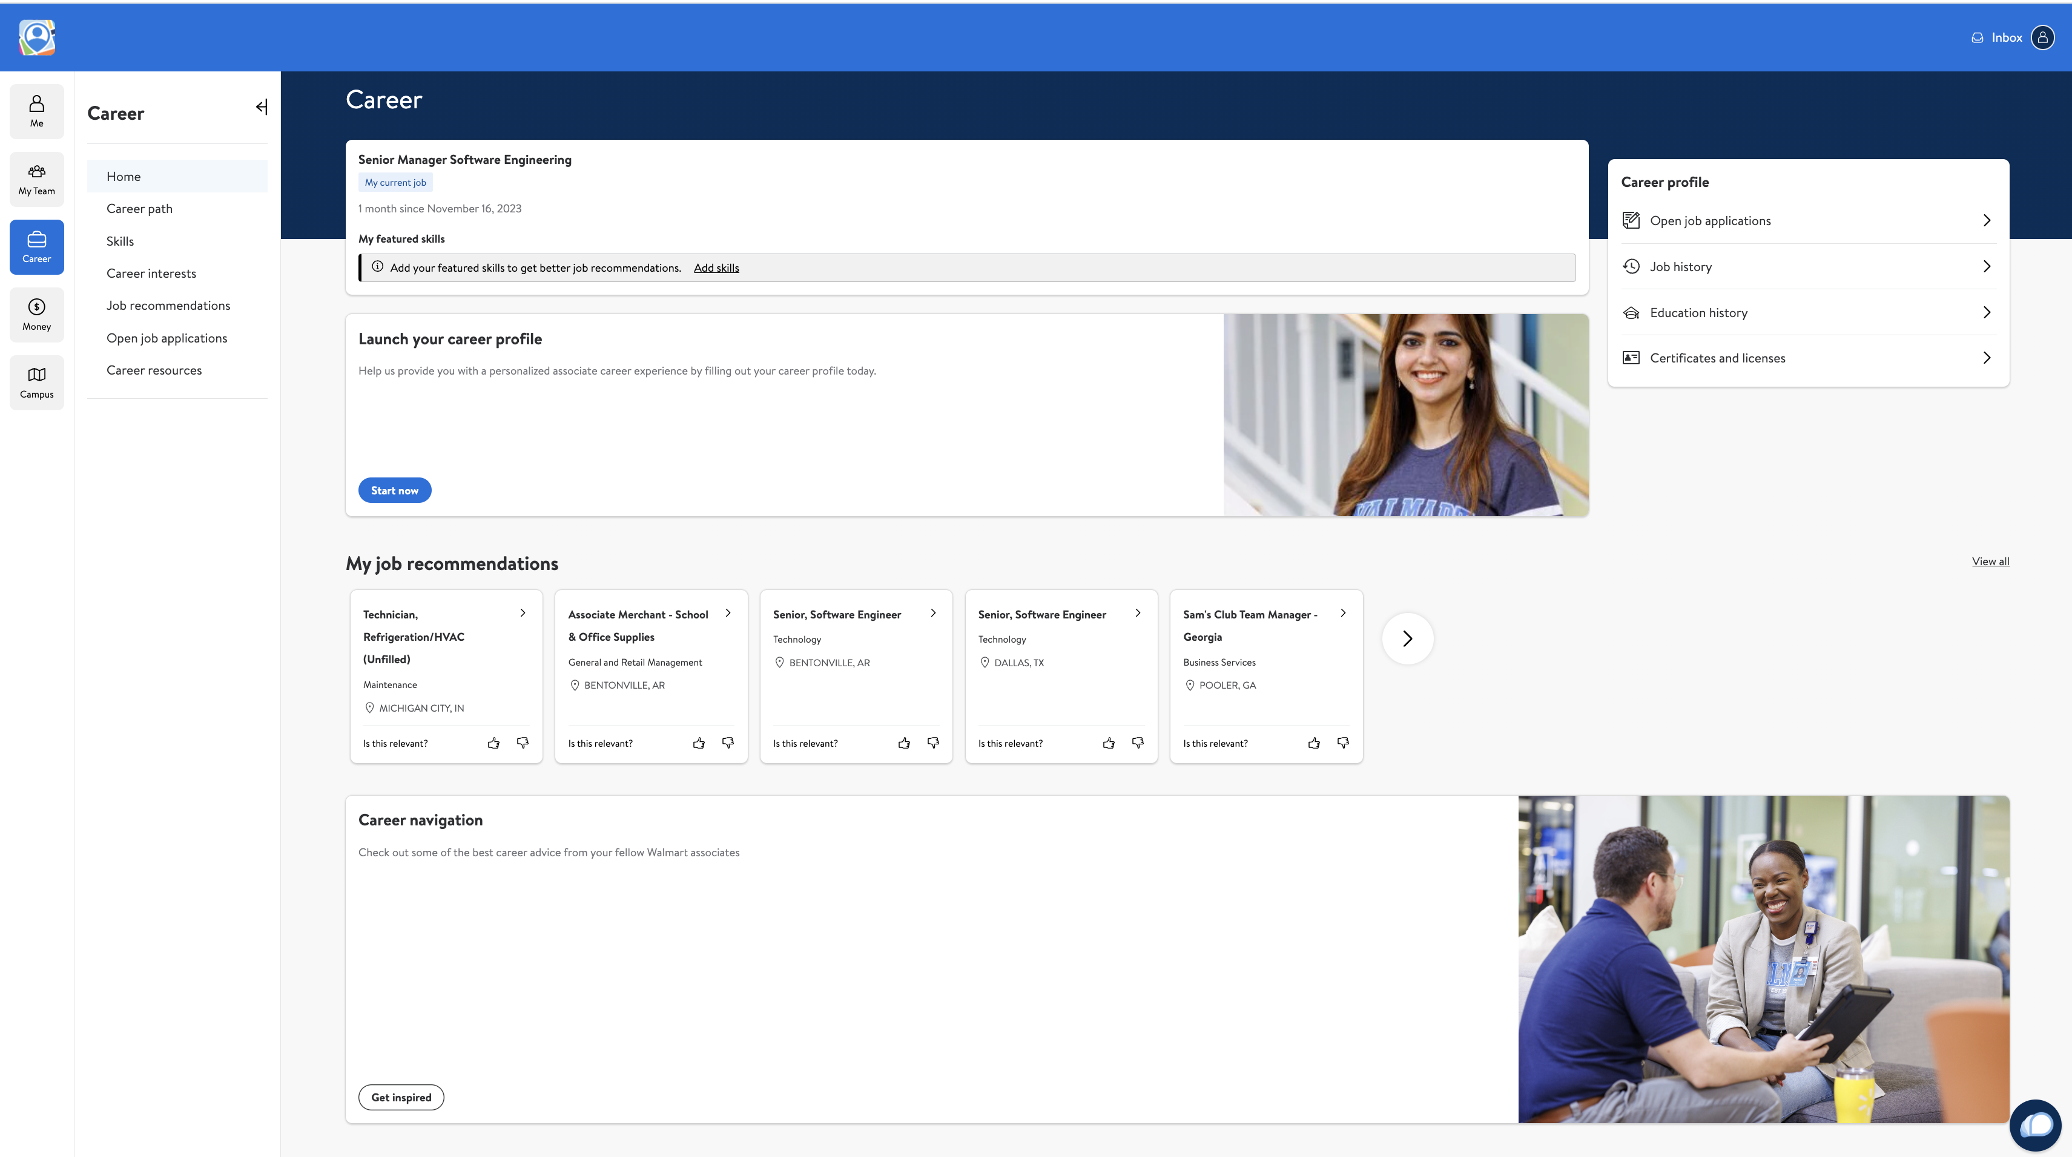
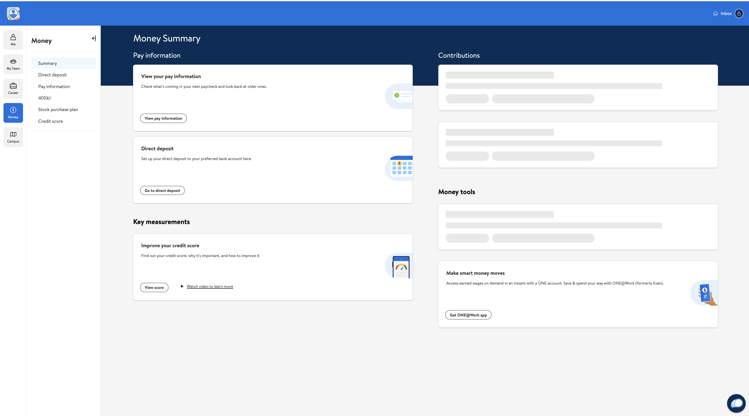
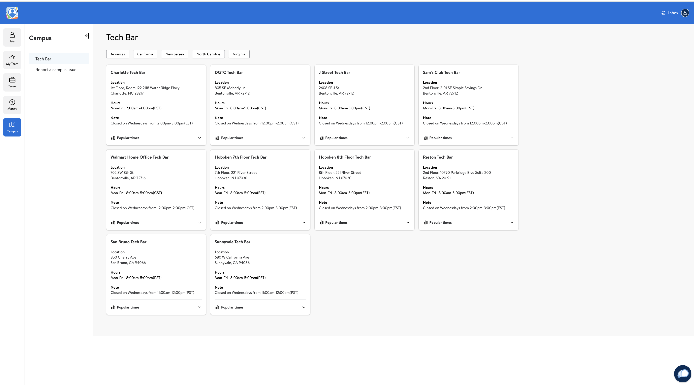
Me@Campus – Deep Dive
Notes:
ME section has personal information, job information, job history etc.
My team give details of their team, onboarding details and manager can see their onboarding details
Carrier feature Walmart associates can create their own profile, get tailor made job notification also they can add skill teir skill.
Allow associates to manage their money – take care personal finances leveraging Walmart Eco- System.
Campus section navigate to a campus, select a particular campus, navigate to a meeting room, and reserve.

Slide 38
MyAssistant – Landing Point
In Platform APP there are Multiple Mini Apps Exist.
Mini Apps are nothing But a self-sufficient Micro services.
Notes:
At Me @Campus page we can see many vuttons and links, which are called Mini-APPs

Slide 39




Who can get benefit from MyAssistant?
Manager
Associate
Human Resource
Resume Search
Onboarding
Interview Recommendation
Leave approval
Skill set mapping
Policy find
Mentoring others

Slide 40
Helpful Links
RESOURCES
Photos
https://corporate.walmart.com/newsroom/media-library
Brand
https://walmartbrandcenter.lingoapp.com/
Scan QR Code
My Assistant link

Slide 41
Slide Title
HEADING
Header
Header
We aim to build a better world — helping people live better and renew the planet while building thriving, resilient communities.
We aim to build a better world — helping people live better and renew the planet while building thriving, resilient communities.

Slide 42
A Special Event
AUGUST 2023

Slide 43
Global People Town Hall
August — 2023

Slide 44
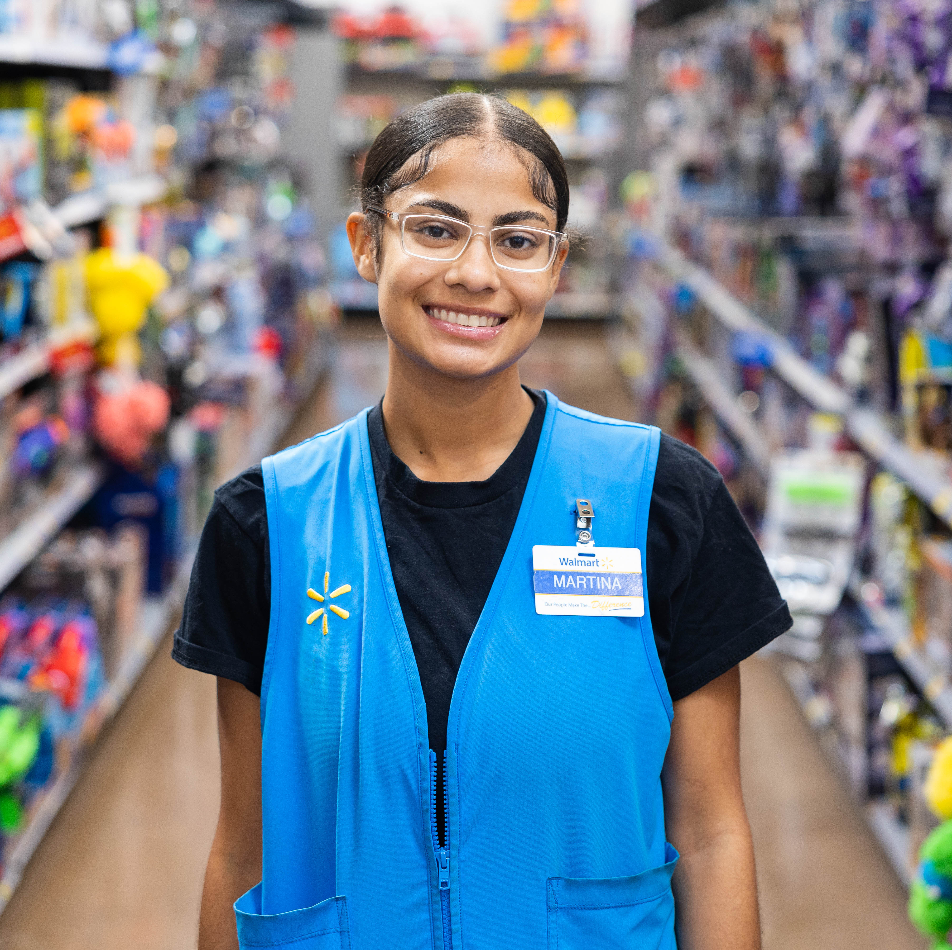
Global People Town Hall
Project/Initiative
August — 2023

Slide 45
Slide Title
HEADING
TOPIC 1
TOPIC 2
TOPIC 3
We aim to build a better world — helping people live better and renew the planet while building thriving, resilient communities.
For us, this means working to create opportunity, build a more sustainable future, advance diversity, equity and inclusion and bring communities closer together.
We aim to build a better world — helping people live better and renew the planet while building thriving, resilient communities.
For us, this means working to create opportunity, build a more sustainable future, advance diversity, equity and inclusion and bring communities closer together.
We aim to build a better world — helping people live better and renew the planet while building thriving, resilient communities.
For us, this means working to create opportunity, build a more sustainable future, advance diversity, equity and inclusion and bring communities closer together.

Slide 46
Side Photo Slide
HEADING
Heading
Communicate everything you possibly can to your partners. The more they know, the more they'll understand. The more they understand, the more they'll care. Once they care, there's no stopping them.

Slide 47
Slide Title
HEADING
Heading
An AI-powered chatbot integrated with Walmart knowledge and multi-faceted capabilities designed for Walmart associates.

Slide 48
MyAsssitant Foundation
HEADING

Slide 49
New Section
HEADER

Slide 50
Slide Title
HEADING

